Slide 1
An Overview of
USPTO Operations
David J. Kappos
Under Secretary of Commerce for Intellectual Property and Director of the U.S. Patent and Trademark Office

Slide 2
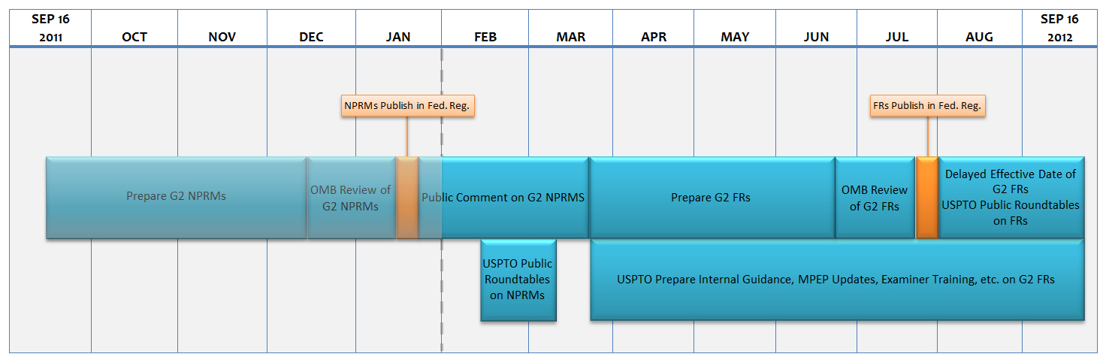
America Invents Act (AIA)
12 Month Timeline

Slide 3
Implemented Provisions
(Effective on September 16, 2011 or within 60 days)
 | AIA Provision | Implementation Documents
1 | Change in inter partes reexamination standard | Revision of Standard for Granting an Inter Partes Reexamination Request, 76 Fed. Reg. 59055 (Sept. 23, 2011)
2 | Tax strategies are deemed within the prior art | Memo to Examiners, Sept. 20, 2011
3 | Best mode | Memo to Examiners, Sept. 20, 2011
4 | Human organism prohibition | Memo to Examiners, Sept. 20, 2011
5 | Prioritized examination | Changes to Implement Prioritized Examination Track (Track I) of the Enhanced Examination Timing Control Procedures Under the Leahy-Smith America Invents Act, 76 Fed. Reg. 59050 (Sept. 23, 2011)
6 | 15% transition surcharge | Notice of Availability of Patent Fee Changes Under the Leahy-Smith America Invents Act, 76 Fed. Reg. 59115 (Sept. 23, 2011)
7 | Electronic filing incentive | Notice of Availability of Patent Fee Changes Under the Leahy-Smith America Invents Act, 76 Fed. Reg. 59115 (Sept. 23, 2011); and Fee for Filing a Patent Application Other than by the Electronic System, 79 Fed. Reg. 70651 (Nov. 15, 2011)

Slide 4
Track I Statistics
 | Petitions Filed | Days to Petition Decision | % Petitions Granted | Days from Petition to first Office action
Number of Track I Applications | 2,124 | 44.6 | 99% | 36
Examination Status | First Action on Merits mailed | Final Dispositions mailed | Allowances Mailed
Number of Track I applications | 991 | 3 | 59

Slide 5
Proposed Rules in Progress
(12 Month timeline)
NPRMs Published as of January 25, 2012 | NPRMs Publishing this Week
Inventor’s oath / declaration | Inter partes review
Third party submission of prior art in a patent application | Post grant review
Citation of prior art in a patent file | Transitional program for covered business method patents
OED Statute of Limitations | Derivation
Supplemental examination

Slide 6
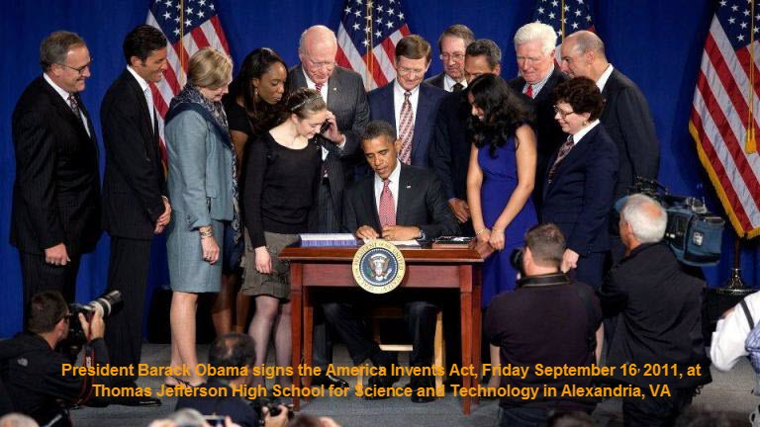
AIA Micro-Site
USPTO’s website devoted to America Invents Act legislation
One-stop shopping for all America Invents Act information
Full text of bill and summary documents, including legislative history
Implementation plans
Announcements
Points of contact
http://www.uspto.gov/AmericaInventsAct

Slide 7
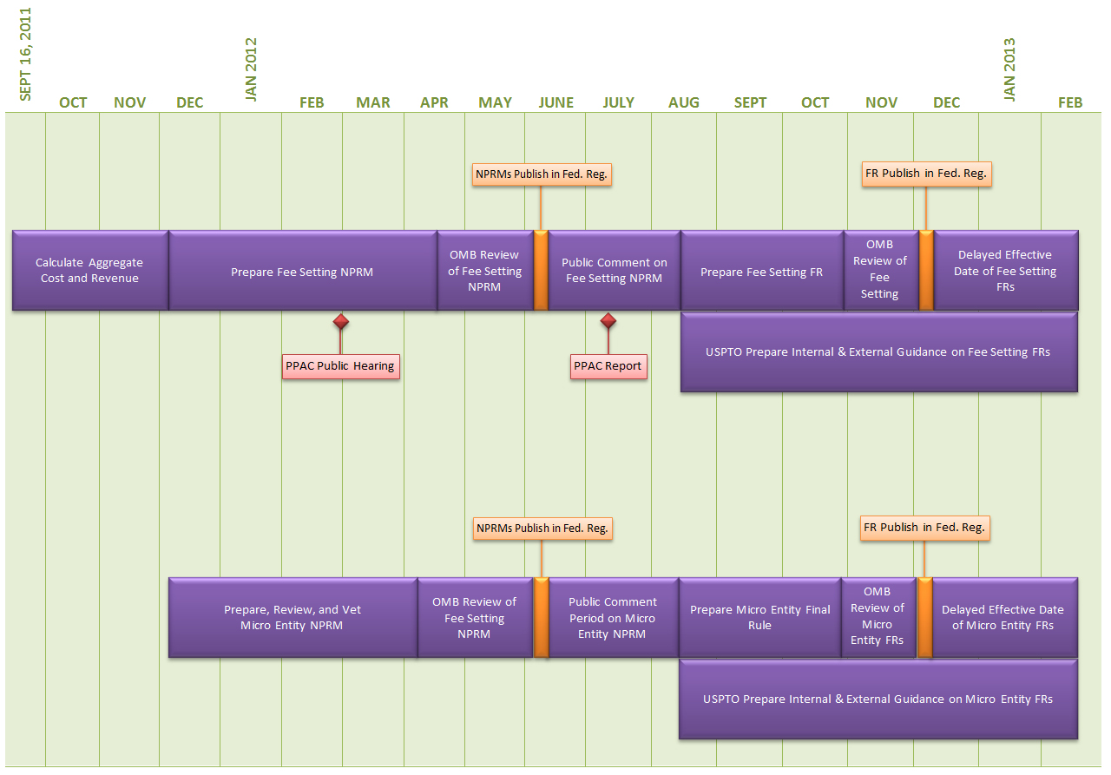
Fee Setting 17 Month Timeline

Slide 8
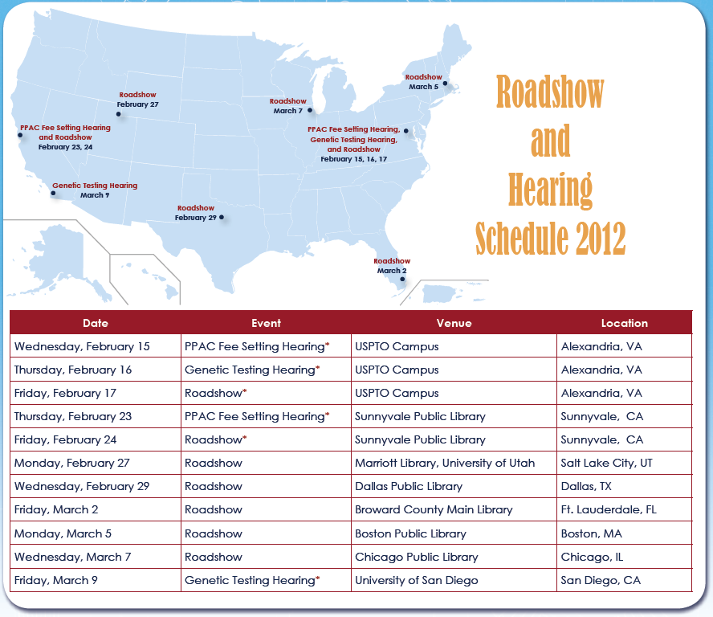
AIA Roadshows and Hearings www.uspto.gov/AmericaInventsAct

Slide 9
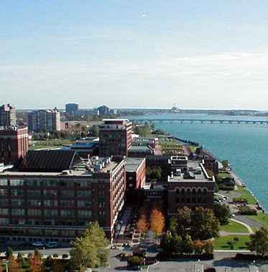
Elijah J. McCoy Satellite Office Detroit, MI
Scheduled: July 2012
100 ‘IP Experienced’ Patent Examiners to be hired in first year of operation
Office will have a Board of Patent Appeals Presence
1 of 3 planned Satellite Offices
9

Slide 10
Applications Awaiting First Action
FY 2009 – FY 2012 (through January)
658,647 as of February 6th.
Preliminary FY 2012 Target:
621,800
Notes:
Current Backlog at midyear FY 2011 is 705,028.
10

Slide 11
Total UPR and RCE Filings
FY 2001 – FY 2012 (projections)
FY 12 data are projections.
Preliminary FY 2012 Target:
533,300

Slide 12
RCE Backlog
FY 2010 – FY 2012 (through January)
80,608 as of February 6th.
Notes:
Current Backlog at midyear FY 2011 is 705,028.
12

Slide 13
First Action Pendency &Total Pendency
FY 2009 – FY 2012 (through January)
Preliminary FY 2012 First action Target:
22.5 Months
Preliminary FY 2012 Total Pendency Target:
34.7 Months

Slide 14
Forward Looking First Action Pendency
FY 2009 – FY 2012 (through January)
Forward Looking Pendency represents an estimate of the average number of months it would take to complete a first Office action under current and projected workload and resource levels for an application filed at the given date.

Slide 15
Interview Time
FY 2008 – FY 2012 (through December)
43,486 hours as of January 14th, 2012, compared with 38,531 hours as of January 14th, 2011.

Slide 16
Clearing the Oldest Patent Applications COPA 2.0 - FY 2012 (through 1/28/12)
FY2012 Goal:
260,000 Cases
163,206 Tail Cases
Needed for Goal
207,206
Total Tail Cases
Remaining
96,794
Tail Cases
Worked
  FY 2012 COPA Backlog (Tail): Applications with filing dates on or before September 1st, 2010 (304,000 on Oct. 1, 2011)
  FY 2012 Goal: Reduce COPA Backlog (Tail) by 260,000 applications

Slide 17
12 Month Rolling Average Actions Per Disposal, by
Bi-Week FY 2009 – FY 2012 (through January 28th)
Actions Per Disposal Target
Sustained decrease in actions per disposal is a positive indicator – issues are being resolved efficiently.

Slide 18
12 Month Rolling Average Allowance Rate, by Bi-Week FY 2009 – FY 2012 (through January 28th)
Sustained increase in allowance rate is a positive indicator – it shows increased efficiency of the workforce.

Slide 19
Central Re-examination Unit (CRU)
Significant decline in pendency: Increased staffing; Pilot program for waiving the statement period; Streamlined process for handling petitions and publication of certificates
2011

Slide 20
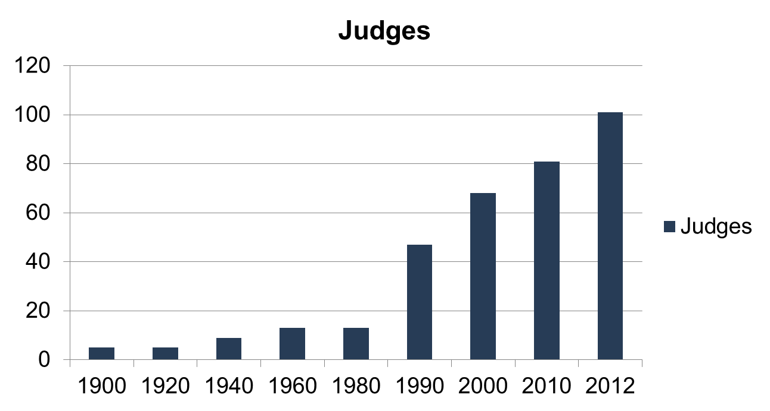
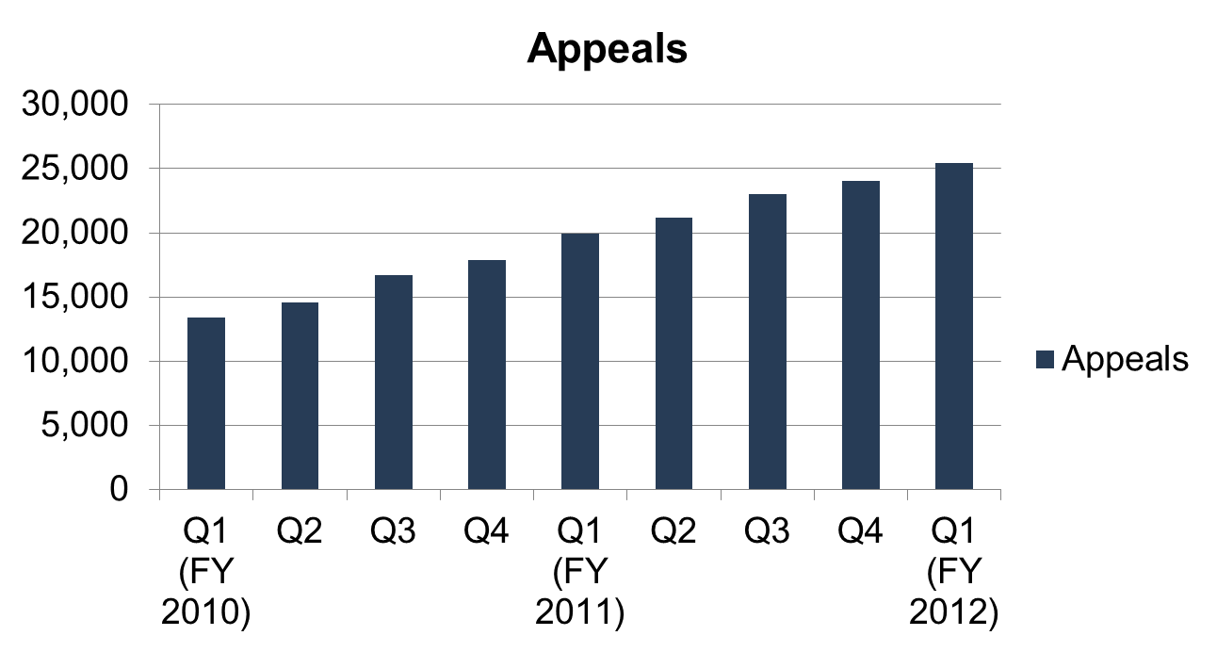
Board of Patent Appeals & Interferences
*Aggressive hiring to tackle BPAI backlog

Slide 21
Quality Measures
Final Disposition, In-Process and QIR
12 Month Rolling Average
FY 2009 – FY 2012 (through January)
2012 Final Disposition Compliance Rate Target Range
(95.6% - 96.7%). Actual as of January: 95.9%
2012 In-Process Compliance Rate Target Range
(94.6% - 96.0%). Actual as of January: 96.3%
2012 Quality Index Reporting Target Range
(88.3% - 91.60%). Actual as of January: 89.5%
Notes:
Quality data are compiled on a quarterly basis.

Slide 22
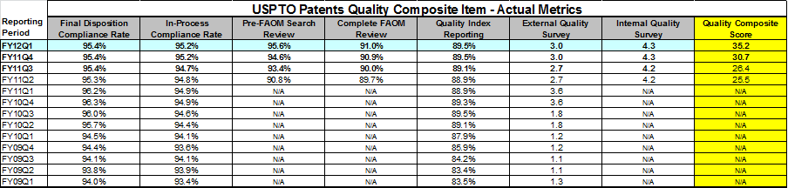
Quality Measures
Notes:
Quality data are compiled on a quarterly basis.

Slide 23
Green Technologies Pilot
December 2009 – January 31st, 2012
Notes:
Many petitions are dismissed because the applications are not classified in a class/subclass eligible for Green Tech. These petitions are now being handled by the TCs (since the issue is whether they fall within the right technology, the TCs are better equipped to make this decision rather than a centralized petitions area).
We will continue to monitor and analyze the data, and take appropriate actions to decrease the number of dismissal.

Slide 24

Current Patent Prosecution Highway (PPH)
Programs
  Russia (Rospatent)
  Israel (ILPO)
  Taiwan (TIPO)
  Hungary (HPO)
  Spain (SPTO)
  Austria (APO)
  Singapore (IPOS)
  Mexico (IMPI)
  Japan (JPO)
  Korea (KIPO)
  China (SIPO)
  European Patent Office (EPO)
  Germany (DPMA)
  Australia (IPAU)
  Canada (CIPO)
  United Kingdom (UKIPO)
  Denmark (DKPTO)
  Iceland (IPO)
  Norway (NIPO)
  Nordic Patent Institute (NPI)
  Finland (NBPR)
  Sweden (PRV)

Slide 25
PPH Requests at USPTO
USPTO goal for PPH requests in calendar year 2011: 8,000
Status as of December 31:
Paris-PPH | 6,354
PCT-PPH | 2,622
Total | 8,976
PPH results compared with all cases:
 | Paris-PPH | PCT-PPH | All Cases
Grant Rate (Allowances/Total Number of Disposals) | 89% | 96% | 47%
Actions per Disposal | 2.13 | 1.61 | 2.49
Notes:
You have in front of you our most recent status report. In it you will find all the data we track on the PPH program.
I am going to touch on just a few high-level statistics we pay particular interest to, to give a sense of how these programs are progressing.
Here we see the total number of PPH requests to date – for both Paris and PCT routes.
I am very pleased with these numbers and am very optimistic that, if the general trend continues and we institute some of the improvements we will discuss today, these numbers will increase dramatically.

Slide 26

Cooperative Patent
Classification (CPC)
CPC Milestone | Timeframe
Introduction to CPC for all examiners. | 2012
Develop Examiner Training with EPO. | 2012-2014
Contractors apply CPC symbols to PGPUB pipeline documents. | January 1, 2013
USPC and CPC symbols will be searchable in EAST/WEST, while routing remains based on USPC. | 2013
CPC symbols will propagate from PGPUB to Grants | 2013
Examiners will begin to add CPC symbols as needed on issued applications, with voluntary search capability of CPC symbols in EAST/WEST. | 2013-2014
Final stage of CPC implementation. | 2015

Slide 27
Trademark Performance:
Application Filings
FY 2010: 368,939 classes
FY 2011: 398,667 classes
FY 2012 : projected 413,000 classes
Notes:
2009: 12.3% drop in filings
2010: up 5% over 2009
2011: up 8.1% over 2010
2012: projected 3%-4% over 2011, currently about 7% higher than the same period last year.

Slide 28
Trademark Performance:
Quality
FY 2011 Trademark Performance Measures | FY 2012 Targets | FY 2012 Q1 Results
FIRST ACTION COMPLIANCE In-process review evaluation of the statutory bases for which the Office raises issues and or refuses marks for registration based on the first office action. | 95.5% | 94.1%*
FINAL ACTION COMPLIANCE In-process review evaluation of the statutory bases for which the Office raises issues and or refuses marks for registration based on the examiner’s approval or denial of the application. | 97.0% | 96.4%*
EXCELLENT OFFICE ACTION New measure for FY 2011 indicating the comprehensive quality of the first Office action search, evidence, writing and decision making. | 20.0% | 22.1%
  *Preliminary Numbers
Notes:
1st Quarter results are based upon a limited number of cases reviewed in a three month period. We expect to meet the goals by the end of the fiscal year.
FY 2011 Results:
First Action: 96.5%
Final Action: 97.0%
Excellent: 23.6%

Slide 29
New TM Performance Measure:
Excellent Office Actions
  Criteria for Excellence*
  1. Correctness in decision making
  Quality of the search
  Quality and relevance of evidence
  Clarity of the written Office Action
  *Office action must meet all 4 criteria to be considered excellent
Notes:
After receiving input from several of our user groups and the public, Trademarks has created an Excellent Office Action Initiative that reviews first actions for comprehensive excellence.
We’ve added an incentive award to reach the Excellence standard along with a required phone usage percentage.

Slide 30
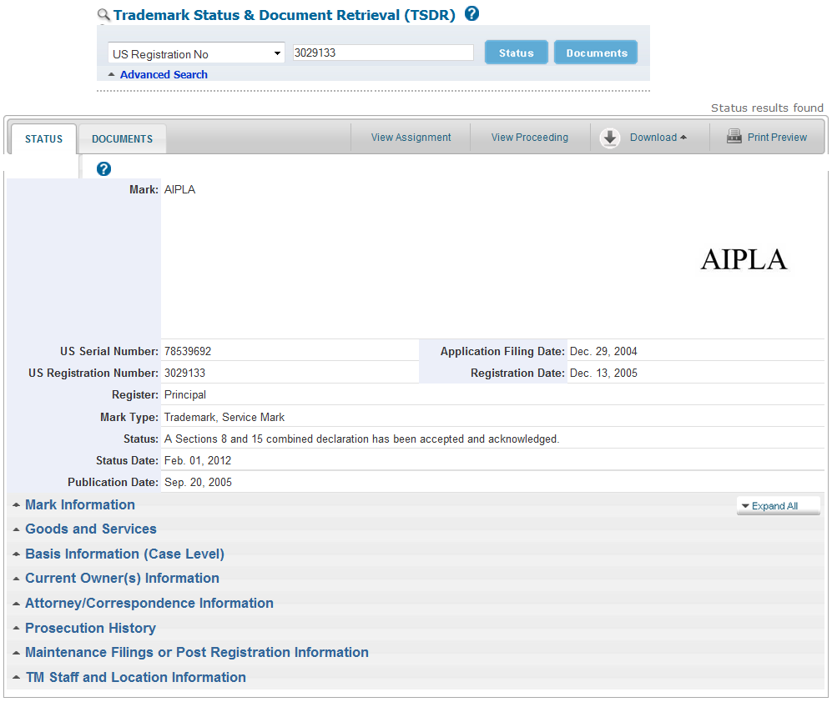
Trademarks Next Generation
30
Notes:
It reengineers the existing functionality that TARR and TDR currently provide and adds new features, providing access to one place for viewing, printing, and downloading snapshots of the data the USPTO stores about a trademark application or registration.
New features include:
The ability to preview and print the status content being presented.
The ability to download a PDF or the original form of the status content (an Extensible Markup Language (XML) file).
The ability to view the mark as stored in the USPTO mark image repository, and expand the size thereof through mouse rollover feature.
The organization of content into logical sections, with a more logical arrangement of the content within those sections.
The ability to collapse and expand sections of the data.
The ability to move easily between status and document content.
The presentation of basis data at both the case and class levels.
Links to related properties, where applicable.
Access to Trademark status data without going to the TSDR site via an Application Programming Interface (API), which is accessible via unique URL’s that allow the retrieval of data in a specified format (PDF or XML).
Significant decrease in the amount of time between an update to the internal USPTO database record and what is available externally (seconds as opposed to hours)
30

Slide 31
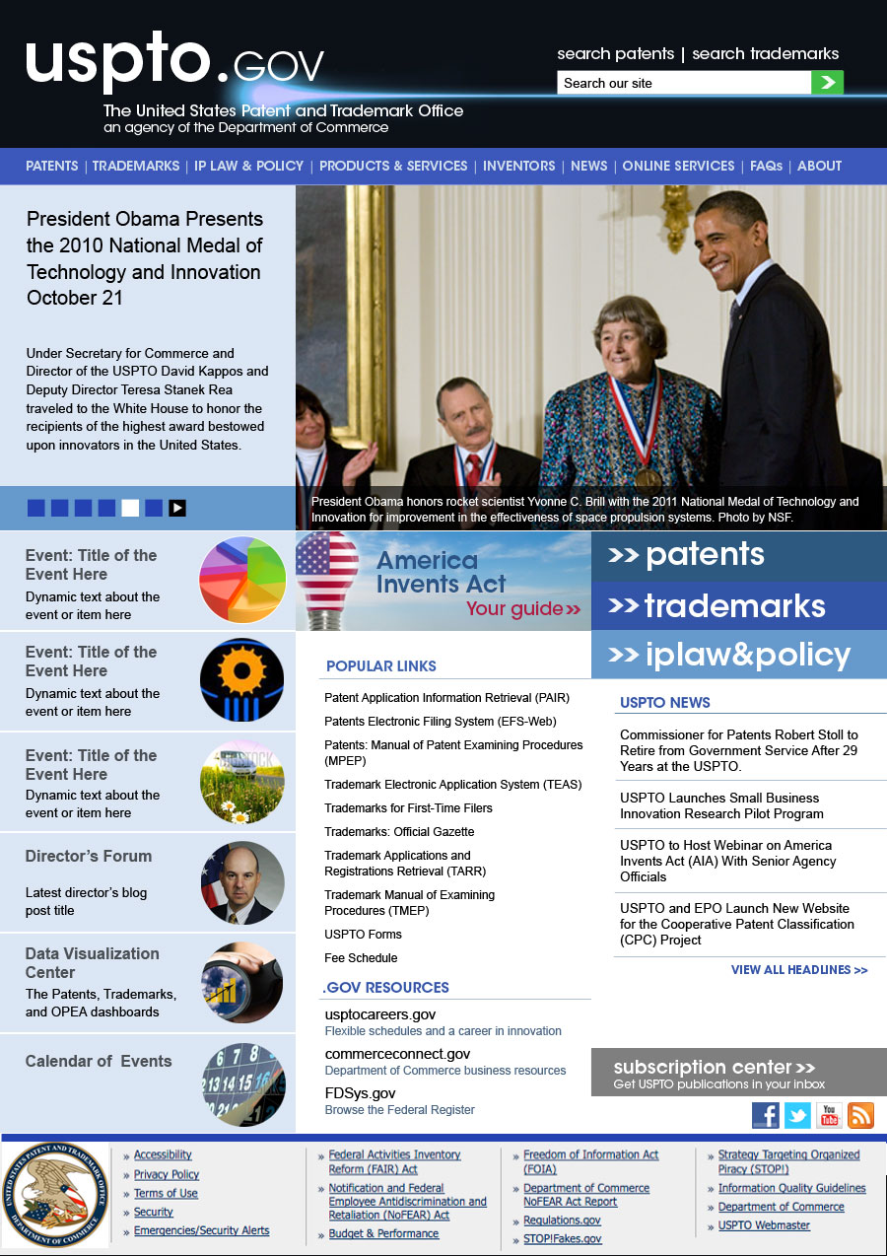

Slide 32
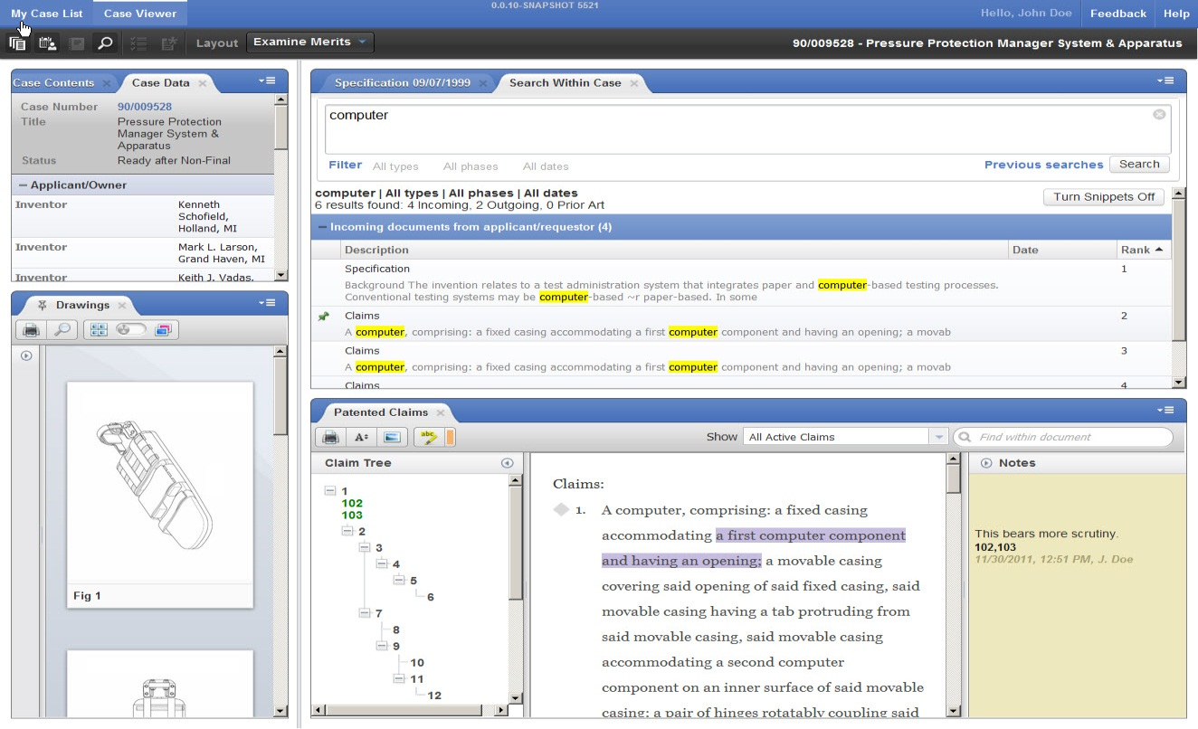
Patents End-to-End (PE2E)
IT Overhaul for the 21st Century
Dynamic views of drawings, claims, and annotations
Greater Examination & Agency Efficiency

Slide 33
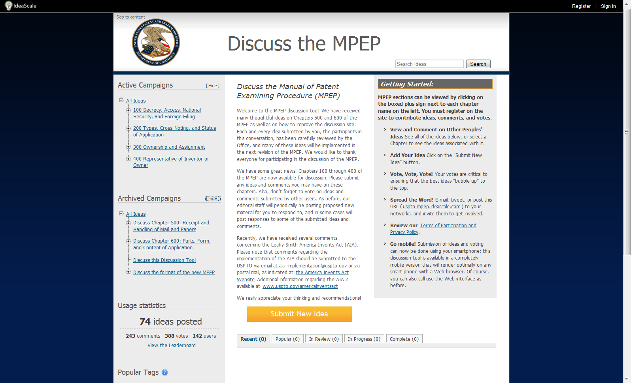
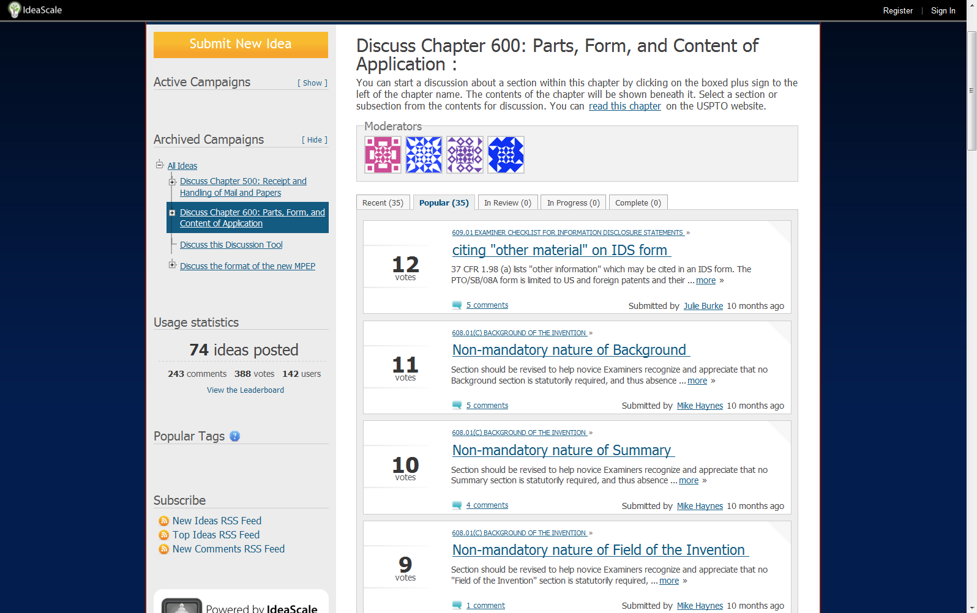
MPEP

Slide 34
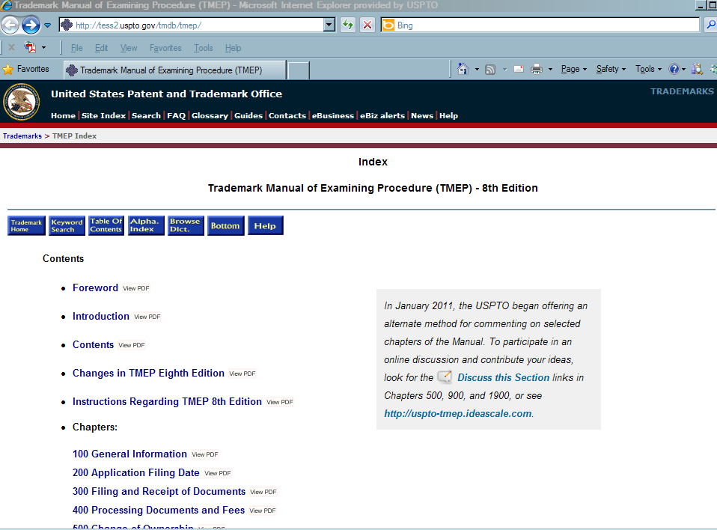
TMEP
IdeaScale Links

Slide 35
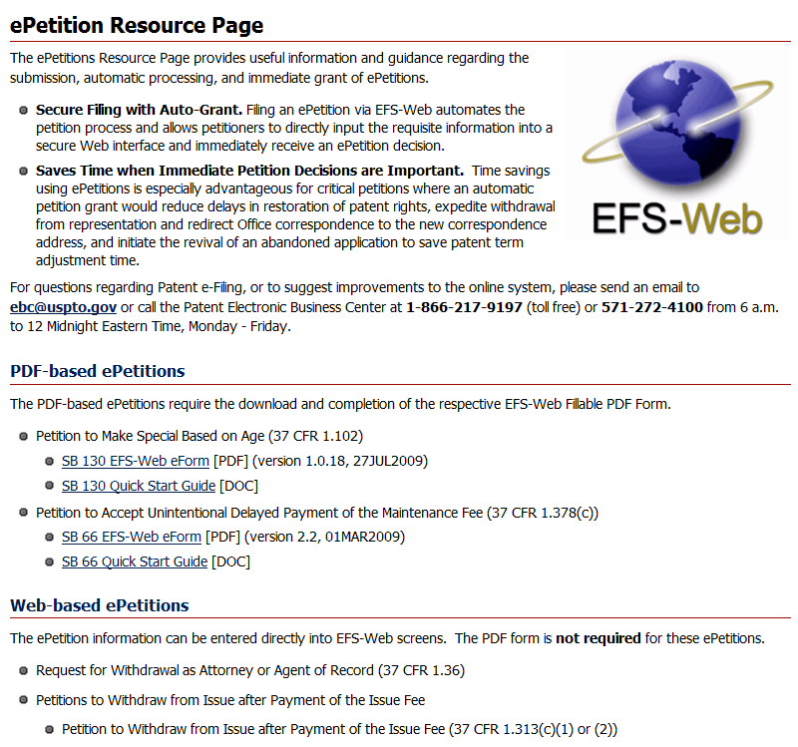
ePetitions
  http://www.uspto.gov/patents/process/file/efs/guidance/epetition-info.jsp

Slide 36
Thank You

